Slide 1
Enhance the Quality of Recommendation System in E-Commerce Application
Need is the mother of Invention

Slide 2

Research Goal
The goal of this research is to improve the quality of recommendations in e-commerce applications by using a hybrid recommender system

Slide 3
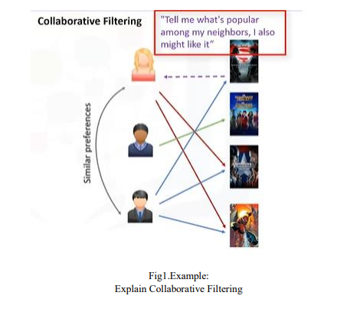
METHODOLOGY
Collaborative filtering

Slide 4
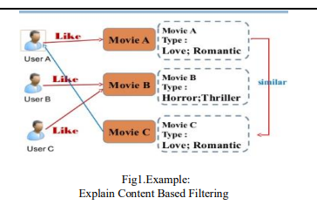
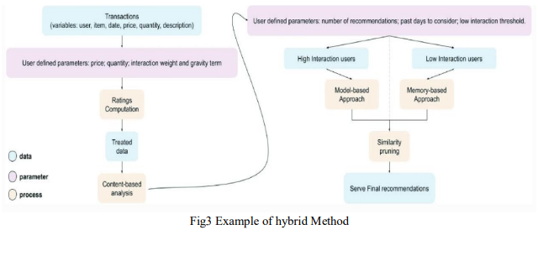
METHODOLOGY
Content Based Filtering
Hybrid Filtering

Slide 5
Research Results
Enhanced Recommendation system
Solve the cold start problem
Overcoming the limitations of individual systems

Slide 6
Claims
1
2
Quality Improvements
Various Implementations
3
Addressing The Challenges

Slide 7
Support
The case study
The paper identifies three challenges:
The cold start problem
The sparsity problem
The user bias problem

Slide 8
Claims and results missing from the paper
Comparisons with other recommendation systems
Scalability with larger datasets
Privacy implications
Alternative evaluation metrics

Slide 9
Next Steps
Evaluation on Diverse Datasets
Comparative Analysis with Existing Systems
Integration of Additional Factors
Scalability Enhancement

Slide 10
NIPS Review
Quality
Clarity
Originality
Significance

Slide 11
Thank You

Slide 12
References
V. Kumar, V. Pal, U. Vashisth and L. Banda, "Enhance the Quality of Recommendation System in E-Commerce Application," 2023 International Conference on Computational Intelligence, Communication Technology and Networking (CICTN), Ghaziabad, India, 2023, pp. 15-19, doi: 10.1109/CICTN57981.2023.10140664.

